Slide 1
Tariffs and Their Effects
Alan V. Deardorff
University of Michigan
Presentation to Bradley University
February 26, 2025

Slide 2
What Is a Tariff?
A tariff is a tax on imports.
Much like, say, the 6% sales tax in Michigan,
  Whatever price the seller charges, the buyer pays an extra 6% that goes to the government.
A 10% tariff on all imports (such as Trump has proposed) would mean that
  Whatever the foreign exporter charges for a product,
  US buyers will pay an extra 10% to the US government.
Might the seller charge a lower price because of the tariff?
  Perhaps, but when Trump used tariffs in 2018 on steel and China, they did not.

Slide 3
Outline
US Tariff History
Trump I Tariffs
Trump II Tariff Proposals
Tariff Effects in General
Effects of Trump II Tariffs

Slide 4
US Tariff History

Slide 5
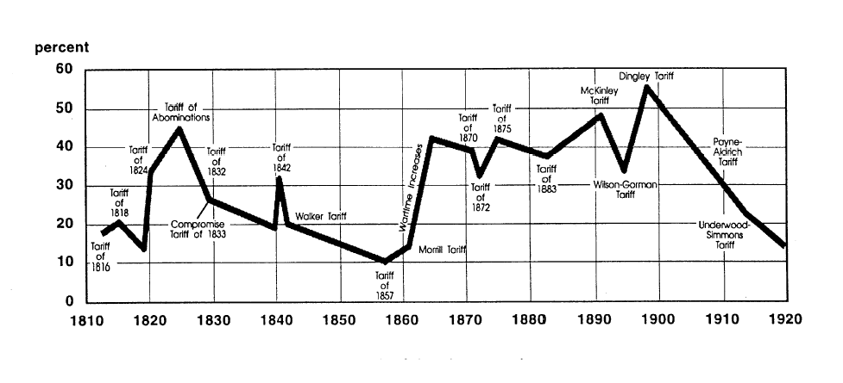
US Tariff History, 1810-1920
Trump points to this, and to President McKinley, as a good example.
Today, pre-Trump
Notes:
Source: Don’t know

Slide 6
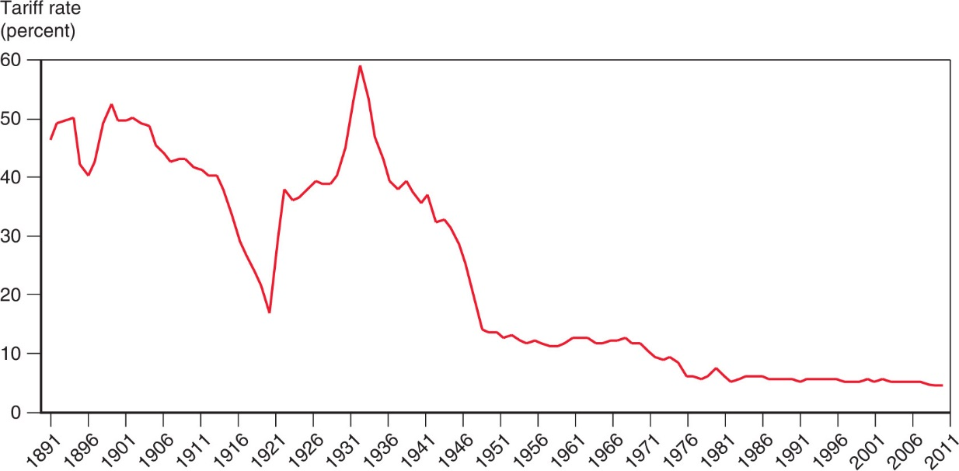
US Tariff History, 1891-2011
Smoot-Hawley Tariff
1934 Reciprocal Trade Agreements Act
1947 GATT
1995 WTO

Slide 7
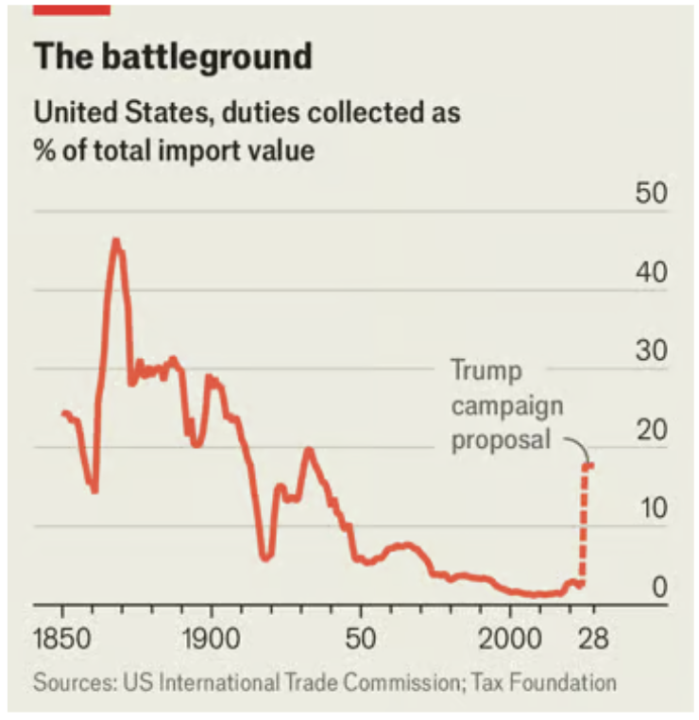
US Tariff History, 1850-2028?
Smoot-Hawley Tariff
Trump 2018 trade war
Notes:
Economist, “Prepare for battle: Will Elon Musk dominate President Trump’s economic policy?” Economist, January 2, 2025.
https://www.economist.com/finance-and-economics/2025/01/02/will-elon-musk-dominate-president-trumps-economic-policy

Slide 8
Trump I Tariffs and the Trade War

Slide 9
Trump I Tariffs & Trade War
Summary
  Trump placed tariffs of 25% on steel and 10% on aluminum
  Trump place multiple tariffs on China exports, covering at least ¾ of their exports to US
  On request, he exempted some products and firms
  Imports from China fell while imports from others rose
  US trade deficit did not shrink
  Data show no fall in foreign export prices, so tariffs were paid by US buyers
Skip to Trump II

Slide 10
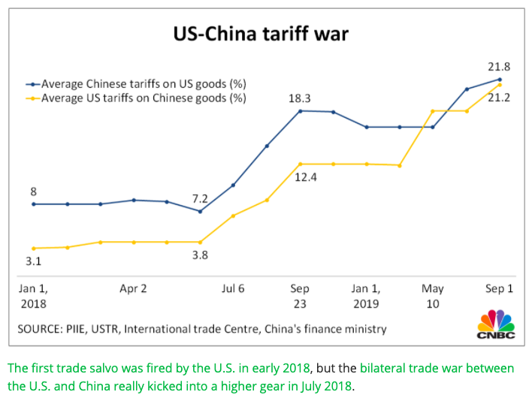
US-China Tariff War – Tariff Rates
Source: CNBC.com
Notes:
SEPTEMBER 18, 2019 | Yen Nee Lee, CNBC.com
http://nbr.com/2019/09/18/these-4-charts-show-how-us-china-trade-has-changed-during-the-tariff-dispute/

Slide 11
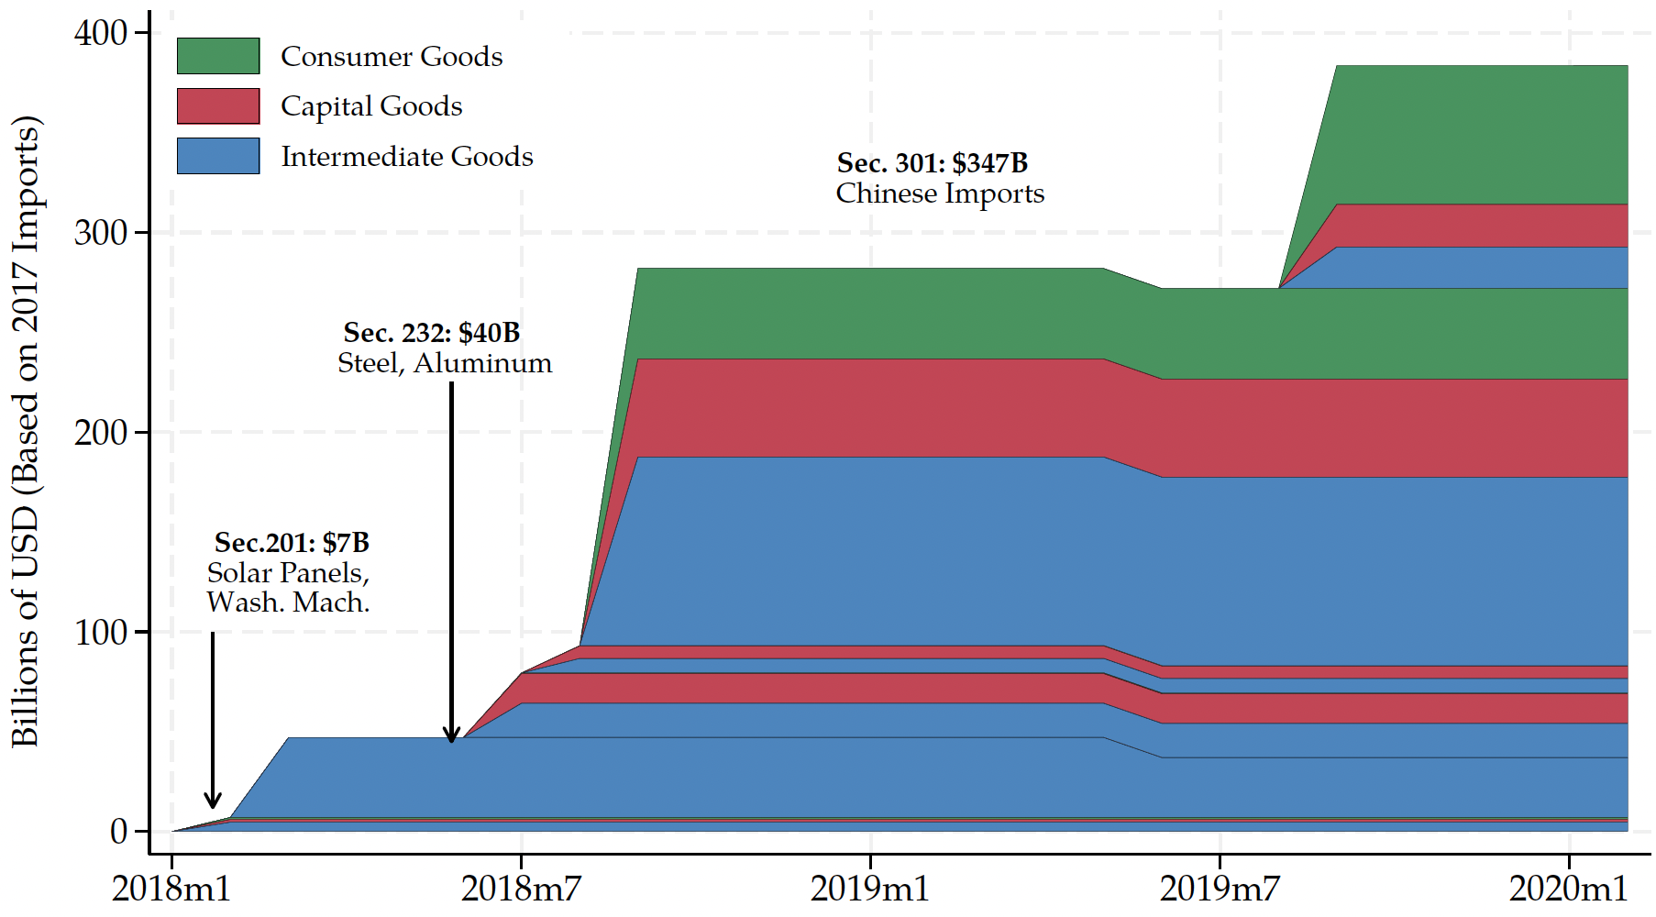
Trump I Tariffs - US Imports Covered
480
US imports from China in 2017, per World Bank:
$480 billion
Source: Flaaen & Pierce 2020
Notes:
SEPTEMBER 18, 2019 | Yen Nee Lee, CNBC.com
http://nbr.com/2019/09/18/these-4-charts-show-how-us-china-trade-has-changed-during-the-tariff-dispute/

Slide 12
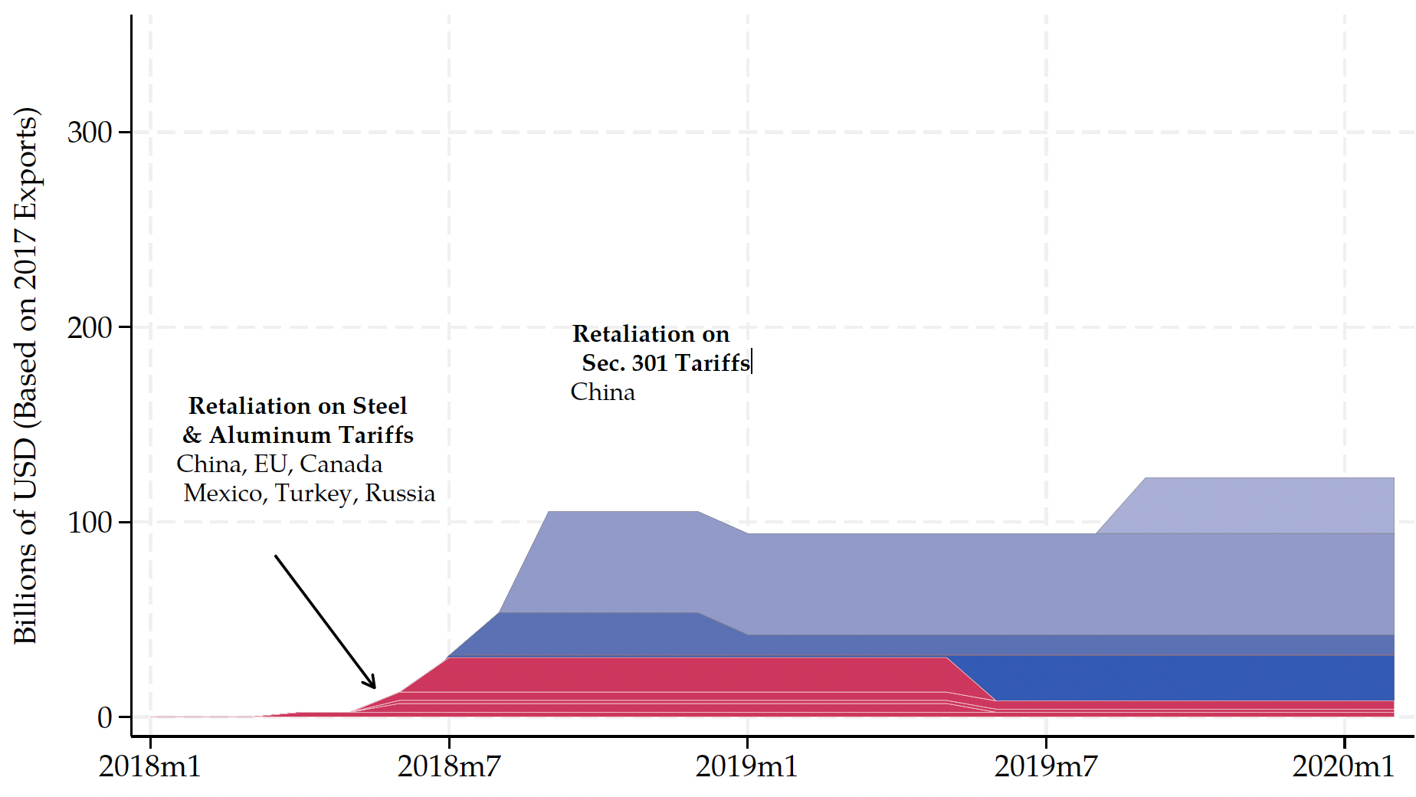
Trump I Tariff Retaliation - US Exports Covered
US exports to China in 2017, per World Bank:
$154 billion
154
Source: Flaaen & Pierce 2020
Notes:
SEPTEMBER 18, 2019 | Yen Nee Lee, CNBC.com
http://nbr.com/2019/09/18/these-4-charts-show-how-us-china-trade-has-changed-during-the-tariff-dispute/

Slide 13
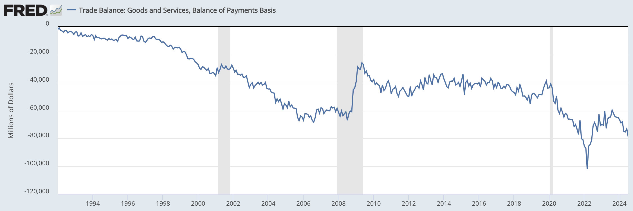
US Trade Balance = Exports minus Imports
Clinton
Bush
Obama
Trump
Biden
Note the zero. This whole thing is negative – a trade deficit! – and getting mostly larger since 1992.
Recessions
Notes:
FRED,
https://fred.stlouisfed.org/series/BOPGSTB
Sep 30, 2024

Slide 14
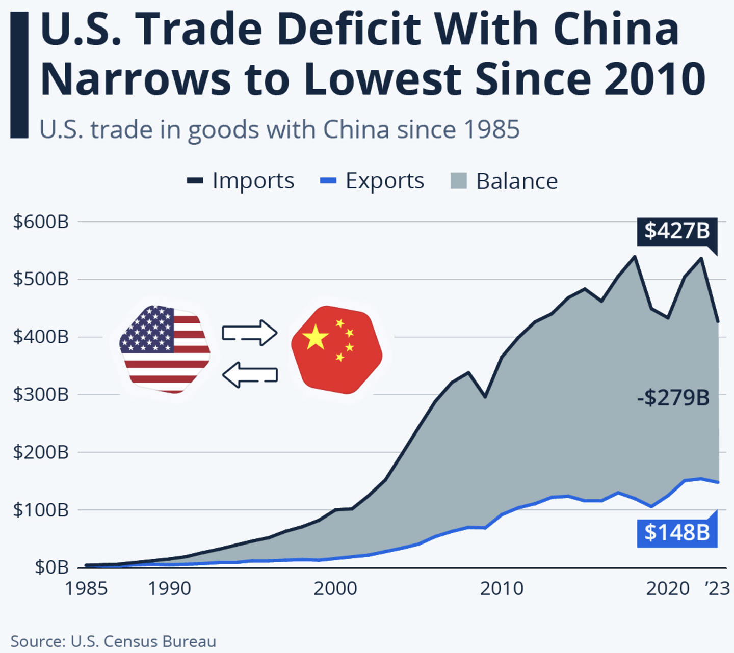
US Trade with China
Notes:
Richter, “Is the U.S. Pulling Away From China Economically?” statista, 11/4/24
https://www.statista.com/chart/17982/us-trade-in-goods-with-china-since-1985/

Slide 15
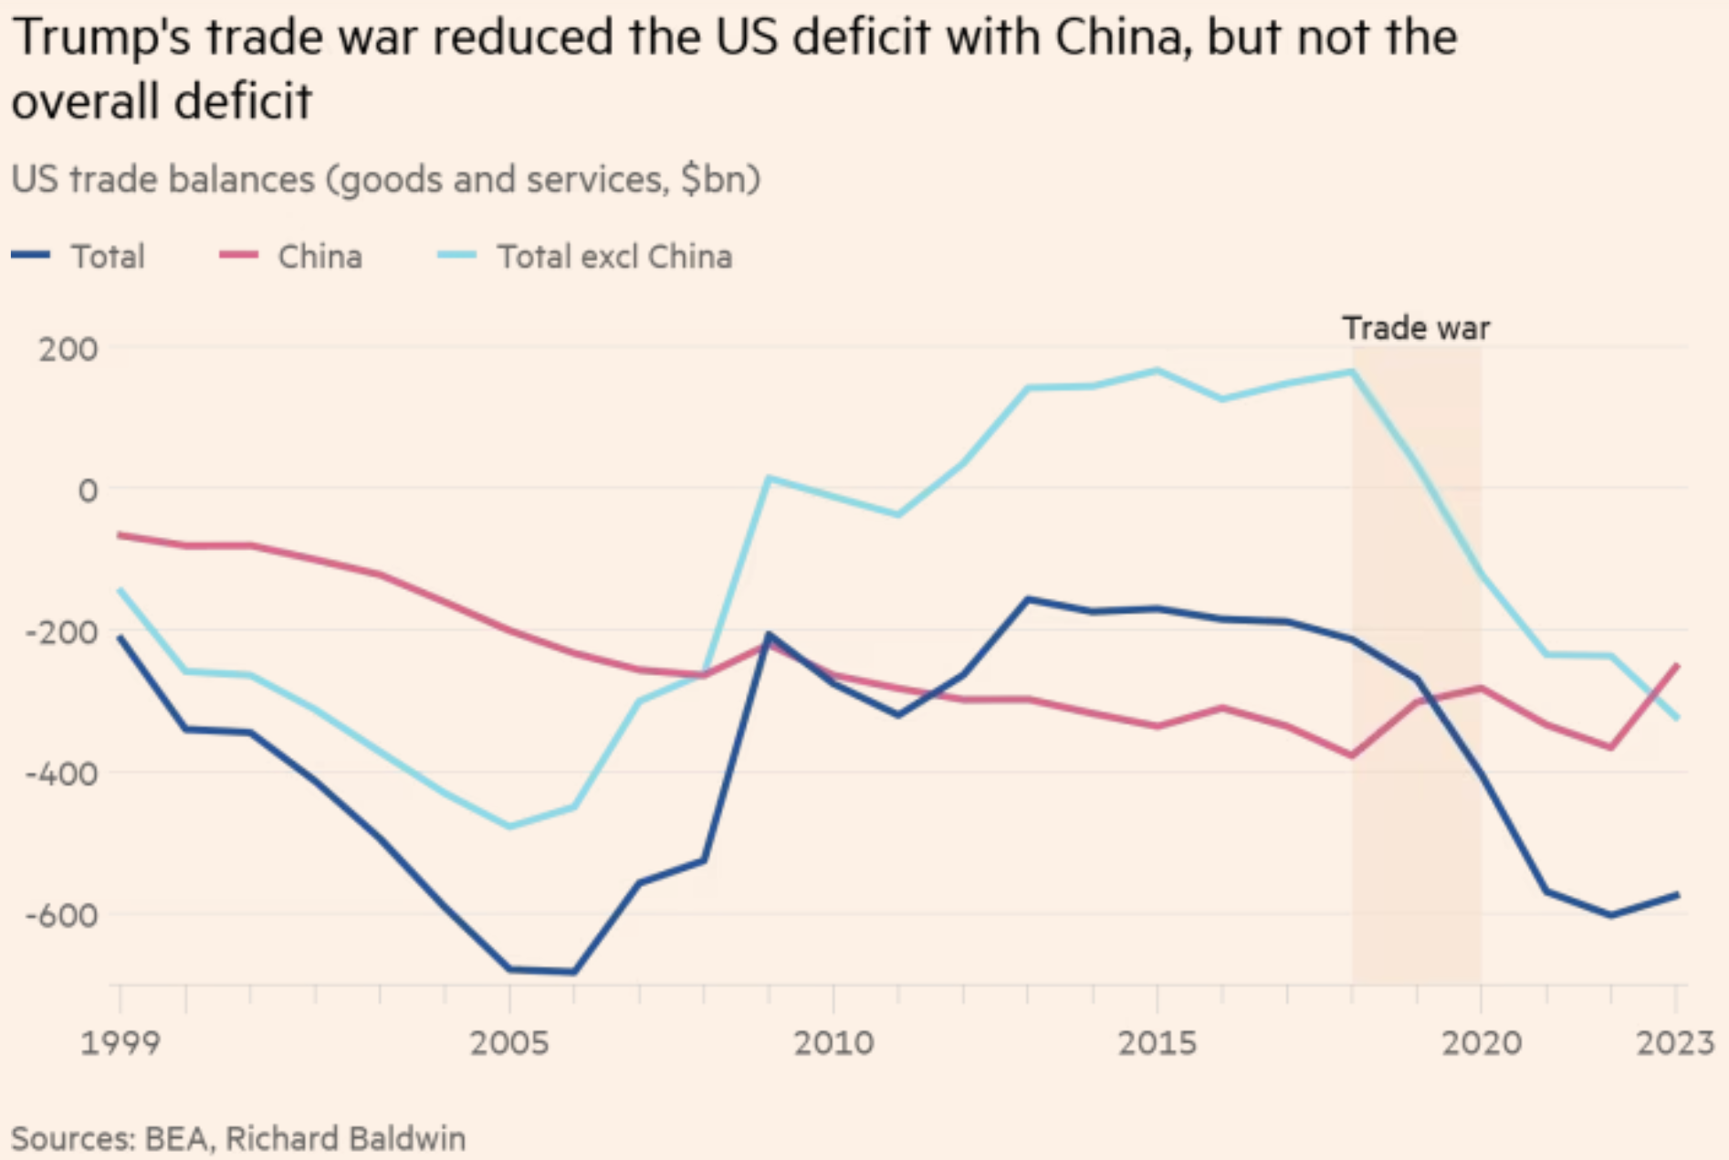
US Trade Balance with China and the World
Deficit
Source:
FT 1/4/25
Notes:
Tett, Gillian, “‘That is Maganomics’: where Trump is taking America on trade,” Financial Times, January 4, 2025.
https://www.ft.com/content/8a97792f-69f9-4885-afdd-4380a2d81dd8

Slide 16
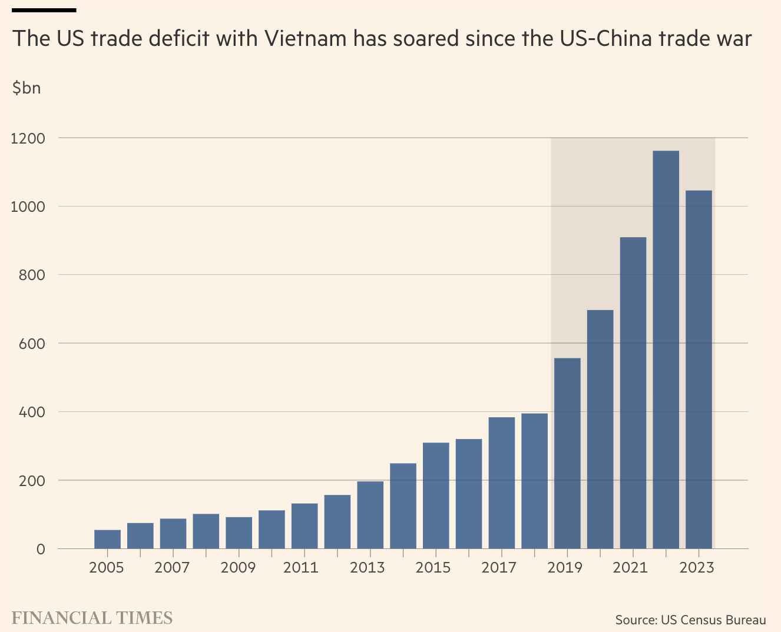
US Trade Balance with Vietnam
Notes:
Lakshmi, “Why Vietnam risks ending up a big loser from Trump’s tariffs,” FT, 11/17/24
https://www.ft.com/content/4f9f11dd-2278-49a6-9e70-b87916667fbe

Slide 17

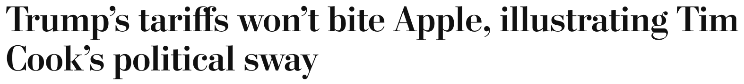
Trump Tariff Exemptions
September 18, 2018:
  “Clearly Tim Cook has been effective in his developing a relationship with the current administration, and this is probably one of the best examples of the fruits of that labor.”

Slide 18
Trump Tariff Exemptions
Both the metals tariffs and the China tariffs permitted certain products and product categories to be exempted, through an application process to Commerce (metals) and USTR (China), if certain criteria are satisfied.
  Whether tariffs would impose significant harm on American business interests
  Whether substitute products were available outside China
  Whether the products were “strategically important” to China”

Slide 19
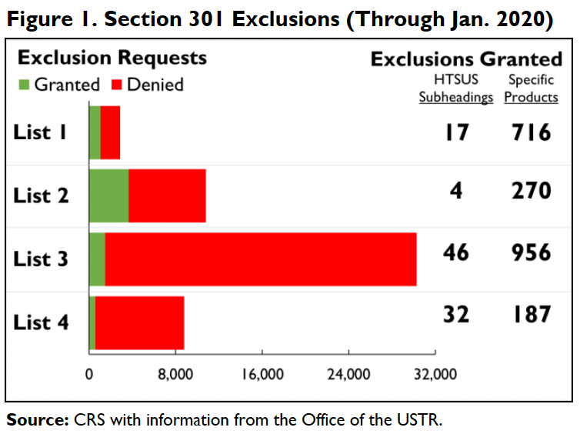
Trump Tariff Exemptions
Notes:
Andres B. Schwarzenberg, “Section 301 Tariff Exclusions on U.S. Imports from China,” Congressional ioal Research Service, May 13, 2024
https://crsreports.congress.gov/product/pdf/IF/IF11582

Slide 20
Trump Tariff Exemptions
Requests for exemption
  Metals tariffs: “Commerce Department received nearly 500,000 exclusion requests”
  China tariffs: USTR “fielded more than 50,000 requests”
“He has also suggested targeting particular companies or industries.”
Lobbying Congress on trade issues increased once Mr. Trump took office
Biden maintained Trump’s tariffs, but it
  gradually wound down the exclusions for China tariffs
  continued to grant them for tariffs on steel and aluminum.
Notes:
Swanson, “Trump’s Trade Agenda Could Benefit Friends and Punish Rivals,” NYT, 11/24/24
https://nytimes.com/2024/11/23/us/politics/trump-tariff-exemptions.html

Slide 21
Trump Tariff Exemptions
Trump administration’s decisions on exclusions were mysterious and arbitrary.
  “Tariff exemptions were given
    to Bibles but not to textbooks,
    to salmon but not to pollock,
    to children’s car seats but not to baby cribs.
  The decisions were not subject to appeal.”
Notes:
Swanson, “Trump’s Trade Agenda Could Benefit Friends and Punish Rivals,” NYT, 11/24/24
https://nytimes.com/2024/11/23/us/politics/trump-tariff-exemptions.html

Slide 22
Trump Tariff Exemptions
Issues with the exemptions
  “Firms hiring lobbyists were less likely to have steel tariff exemptions approved.”
  Study found:
    Contributions to Republicans made China exemptions more likely
    Contributions to Democrats made China exemptions less likely
    Author quoted as saying the exclusion process was “a very effective spoils system”
  Renewal of exemptions were uncertain and came late enough to create uncertainty.
Notes:
Keynes, Soumaya, “Your guide to how to dodge a tariff,” FT, 11/15/24
https://www.ft.com/content/f9e4cc47-5b70-4beb-85df-a49a9f03181c
Armstrong, Dan, “Politically Connected Corporations Received More Exemptions from U.S. Tariffs on Chinese Imports, Study Finds,” Lehigh News, October 8,, 2024
https://www2.lehigh.edu/news/politically-connected-corporations-received-more-exemptions-from-us-tariffs-on-chinese-imports
Swanson, “Trump’s Trade Agenda Could Benefit Friends and Punish Rivals,” NYT, 11/24/24
https://nytimes.com/2024/11/23/us/politics/trump-tariff-exemptions.html
Ben Unglesbee, “Biden administration extends China tariff exclusions — again,” SupplyChainDive, January 4, 2024.
https://www.supplychaindive.com/news/biden-administration-extends-china-tariff-exclusions-May-2024/703510/

Slide 23
Trump II Tariffs

Slide 24
Trump II Tariff Plans
“To me the most beautiful word in the dictionary is ‘tariff’”
During campaign he said he will
  Place a tariff of 10% or 20% on all imports from all countries.
  Place even higher tariffs (60%) on imports from China.
  Raise our tariffs on countries to match what they charge on our exports.
    “Reciprocal Trade Act”
    (And lower those where they charge less?)
  Raise tariffs on countries that don’t use the US dollar for international transactions.
  Place tariffs on Mexico, violating his own USMCA trade agreement
    25% on everything if they don’t stop US immigration
    100% on cars to get production in US
Notes:
McCormick, “Trump Calls Tariffs the ‘Most Beautiful Word’,” WSJ, 10/14/24
https://www.wsj.com/livecoverage/harris-trump-election-10-16-2024/card/trump-calls-tariffs-the-most-beautiful-word--YMVPAupw4EjBRp6yobOy
Swanson, “Harris and Trump Embrace Tariffs, Though Their Approaches Differ,” New York Times, Aug 27, 2024.
https://www.nytimes.com/2024/08/27/us/politics/trump-harris-tariffs.html
Toomey, “About Trump’s ‘Reciprocal’ Tariffs,” WSJ, 10/27/24
https://www.wsj.com/opinion/about-trumps-reciprocal-tariffs-he-wants-to-raise-taxes-and-thinks-im-the-stupid-one-5dc3c56c?mod=itp_wsj
Krugman, “Donald Trump on the Dollar, in His Own Words. NYT, 9/9/24
https://www.nytimes.com/2024/09/09/opinion/trump-tariffs-reserve-currency.html
Economist, “Donald Trump is poised to smash Mexico with tariffs,” 11/7/24
https://www.economist.com/the-americas/2024/11/07/donald-trump-is-poised-to-smash-mexico-with-tariffs
Ewing, “Trump’s Tariffs Could Deal a Blow to Mexico’s Car Factories,” NYT, 11/12/24
https://www.nytimes.com/2024/11/12/business/economy/trump-mexico-trade-tariffs-car-factories.html

Slide 25
Trump II Tariff Plans
After the election he said he threatened:
  Nov 26: New tariffs unless they stop people and drugs crossing border
    25% on Mexico and Canada
    Extra 10% on China
  Nov 30: 100% Tariffs on Brics if they undermine the US dollar
    Brics = Brazil, Russia, India, China and South Africa
      Expanded to include Iran, United Arab Emirates, Egypt and Ethiopia
    A proposal for a Brics currency was introduced at last year’s summit in South Africa.
  Jan 7: Tariffs on Denmark if it doesn’t allow US to buy Greenland
Notes:
McCormick, “Trump Calls Tariffs the ‘Most Beautiful Word’,” WSJ, 10/14/24
https://www.wsj.com/livecoverage/harris-trump-election-10-16-2024/card/trump-calls-tariffs-the-most-beautiful-word--YMVPAupw4EjBRp6yobOy
Swanson, “Harris and Trump Embrace Tariffs, Though Their Approaches Differ,” New York Times, Aug 27, 2024.
https://www.nytimes.com/2024/08/27/us/politics/trump-harris-tariffs.html
Toomey, “About Trump’s ‘Reciprocal’ Tariffs,” WSJ, 10/27/24
https://www.wsj.com/opinion/about-trumps-reciprocal-tariffs-he-wants-to-raise-taxes-and-thinks-im-the-stupid-one-5dc3c56c?mod=itp_wsj
Krugman, “Donald Trump on the Dollar, in His Own Words. NYT, 9/9/24
https://www.nytimes.com/2024/09/09/opinion/trump-tariffs-reserve-currency.html
Economist, “Donald Trump is poised to smash Mexico with tariffs,” 11/7/24
https://www.economist.com/the-americas/2024/11/07/donald-trump-is-poised-to-smash-mexico-with-tariffs
Ewing, “Trump’s Tariffs Could Deal a Blow to Mexico’s Car Factories,” NYT, 11/12/24
https://www.nytimes.com/2024/11/12/business/economy/trump-mexico-trade-tariffs-car-factories.html

Slide 26
Trump II Tariff Actions
After inauguration, as President he:
  Jan 16: Threatened tariffs on Colombia if it doesn’t allow his deportation flights to land
    They first threatened retaliatory tariffs, but then permitted flights to land and Trump retracted the threat

Slide 27
Trump II Tariff Actions
After inauguration, as President he:
  Feb 1: Announced tariffs of 25% on Canada and Mexico and 10% on China if they didn’t stop flows of illegal people and drugs across the borders
    After talks with leaders he postponed the tariffs on Canada and Mexico for one month
      On Feb 24 he said he is “he said he is ‘going forward’ with the tariffs next week.
    The 10% additional tariff on China
      Went into effect Feb 4
      China retaliated with more tariffs on US
Notes:
WSJ editors, “Trump’s Tariffs Will Punish Michigan,” WSJ, Feb 25, 2025
https://www.wsj.com/opinion/trump-tariffs-american-auto-industry-anderson-economic-group-canada-mexico-7beb200a?mod=itp_wsj

Slide 28
Trump II Tariff Actions
After inauguration, as President he:
  Feb 1: Announced repeal of “de minimis” tariff-free policy on imports from China
    For years, imports under $800 have entered US tariff free
    Feb 7: Paused the repeal as packages piled up at customs
Notes:
David Lawder, Helen Reid, Lisa Baertlein and Lisa Barrington, “Trump pauses de minimis repeal as packages pile up at US customs
“ Reuters, Feb 7, 2025
https://www.reuters.com/business/trump-signs-order-delaying-tariffs-de-minimis-imports-china-2025-02-07/

Slide 29
Trump II Tariff Actions
After inauguration, as President he:
  Feb 3: Trump “hinted” that EU would be next
    "They don't take our cars, they don't take our farm products, they take almost nothing and we take everything from them. Millions of cars, tremendous amounts of food and farm products," he told journalists. [BBC]
Notes:
Nomia Iqbal, João da Silva & Michael Race, “EU tariffs 'pretty soon' but UK can be worked out – Trump” BBC Feb 3, 2025
https://www.bbc.com/news/articles/cn4zgx808g7o

Slide 30
Trump II Tariff Actions
After inauguration, as President he:
  Feb 9: Trump announced new 25% tariffs on steel and aluminum from all countries, to take effect on March 12. [NYT]
    Like last time who will actually be covered remains to be seen.
Notes:
Lydia DePillis, “Is It Made of Metal? It Could Get More Expensive Under Trump’s Latest Tariffs.” New York Times, February 11, 2025.
https://www.nytimes.com/2025/02/11/business/economy/tariffs-steel-aluminum-manufacturing.html

Slide 31
Trump II Tariff Actions
After inauguration, as President he:
  Feb 13: Trump starts work on “reciprocal tariffs”
    “Trump Says He’ll Rework Global Trading Relations With ‘Reciprocal’ Tariffs” [NYT]
Notes:
Ana Swanson, “Trump Says He’ll Rework Global Trading Relations With ‘Reciprocal’ Tariffs,” New York Time, Feb, 13,, 2025
https://www.nytimes.com/2025/02/13/us/politics/trump-tariffs.html

Slide 32
Trump II Tariff Actions
After inauguration, as President he:
  Feb 18: Trump threatens tariffs of 25% or more on cars, drugs, and chips.
Notes:
Myles McCormick, “Donald Trump considers 25% tariff on imported cars,” Financial Times, February 18, 2025
https://www.ft.com/content/3645b83e-75b8-4eb0-b027-d6ef0fda7b5f

Slide 33
Trump II Tariff Actions
After inauguration, as President he:
  Feb 21: “Donald Trump is considering tariffs on countries that levy digital services taxes against American companies”
Notes:
Myles McCormick and Demetri Sevastopulo, “Donald Trump considers tariffs to counter digital services taxes on Big Tech
“ FT 2/21/25
https://www.ft.com/content/558b5a20-c25e-483d-8fdc-bbfd2923afd1

Slide 34
Trump II Tariff Actions
After inauguration, as President he:
  Feb 24: Directed Commerce Department to investigate need for tariffs on copper, as threat to national security
Notes:
Myles McCormick, “US orders probe into copper dumping, opening door to new tariffs,” Finsncial Times, Feb 25, 2025.
https://www.ft.com/content/fd1f5a11-4e67-4fd5-9e08-da997a2efcde

Slide 35
Trump II Tariff Plans
What will Trump actually do?
  Beattie in FT 11/18/24: “trade policy in his first administration emerged from fierce internal battles like a victorious but bloodied rat crawling out of a sack of rodent corpses, with Trump’s caprice determining which idea survived.”
  He will surely do some of the things on this list
  But not on everybody. He’ll use threats to negotiate ”deals”
    For the benefit of the country (?)
    For the benefit of himself (!)
Notes:
McCormick, “Trump Calls Tariffs the ‘Most Beautiful Word’,” WSJ, 10/14/24
https://www.wsj.com/livecoverage/harris-trump-election-10-16-2024/card/trump-calls-tariffs-the-most-beautiful-word--YMVPAupw4EjBRp6yobOy
Swanson, “Harris and Trump Embrace Tariffs, Though Their Approaches Differ,” New York Times, Aug 27, 2024.
https://www.nytimes.com/2024/08/27/us/politics/trump-harris-tariffs.html
Toomey, “About Trump’s ‘Reciprocal’ Tariffs,” WSJ, 10/27/24
https://www.wsj.com/opinion/about-trumps-reciprocal-tariffs-he-wants-to-raise-taxes-and-thinks-im-the-stupid-one-5dc3c56c?mod=itp_wsj
Krugman, “Donald Trump on the Dollar, in His Own Words. NYT, 9/9/24
https://www.nytimes.com/2024/09/09/opinion/trump-tariffs-reserve-currency.html
Economist, “Donald Trump is poised to smash Mexico with tariffs,” 11/7/24
https://www.economist.com/the-americas/2024/11/07/donald-trump-is-poised-to-smash-mexico-with-tariffs
Ewing, “Trump’s Tariffs Could Deal a Blow to Mexico’s Car Factories,” NYT, 11/12/24
https://www.nytimes.com/2024/11/12/business/economy/trump-mexico-trade-tariffs-car-factories.html
Beattie, “Where Trump will go with his plans on trade,” FT, 11/18/24
https://www.ft.com/content/afab0fab-524b-4845-addd-bcffbe6b0b22

Slide 36
Trump II Tariff Plans
What will Trump be able do?
  The US Constitution gives power over tariffs only to Congress, not the President
  But Congress has passed laws delegating that power to the President in certain circumstances:
    Section 201 of 1974 Trade Act: Safeguards, used for washing machines
    Section 232 of 1962 Trade Act: National security, used for steel
    Section 301 of 1974 Trade Act: Unfair trade, used for China tariffs
    International Emergency Economic Powers Act of 1977,
      Did not use in his first term
      But threatened against Mexico in 2018 over migration
      Did use on Feb 1 for tariffs on Canada, Mexico, and China
  For his tariffs on all imports, he may need to get Congress to act, but Beatie in FT disagrees
  Reciprocal Trade Act would have to be by Congress

Slide 37
Trump II Tariff Plans
Use of International Emergency Economic Powers Act
  Posted by White House Feb 1, 2025:
ADDRESSING AN EMERGENCY SITUATION: The extraordinary threat posed by illegal aliens and drugs, including deadly fentanyl, constitutes a national emergency under the International Emergency Economic Powers Act (IEEPA).
Notes:
Fact Sheet: President Donald J. Trump Imposes Tariffs on Imports from Canada, Mexico and China, Feb 1, 2025
https://www.whitehouse.gov/fact-sheets/2025/02/fact-sheet-president-donald-j-trump-imposes-tariffs-on-imports-from-canada-mexico-and-china/

Slide 38
Effects of Tariffs in General

Slide 39
Economic effects of a tariff
A tariff is a tax on imports. It causes
  A rise in the price of the imported good in the importing country
  A fall in the price of the imported good in the exporting country
  The quantity imported to fall
  Revenue for the tariff-levying government
Almost always: the rise at home is much larger than the fall abroad
  That’s especially true if importing country is small
  But it’s also true if importing country is as large as the U.S.
    We learned this from Trump’s tariffs in 2018.
    Example: Trump’s tariffs caused US prices to rise, with hardly any perceptible fall in prices abroad.

Slide 40
Effects of a tariff
The rise in price in the importing country causes
  A rise in price of competing goods produced there
  Benefits to those producers
  Harm to buyers of both the import and the competing goods
    Including producers that use the higher-priced goods as inputs
      Their prices also rise, hurting their buyers
  Employment changes:
    Increase in the protected industry
    Decrease in industries that use the protected product as inputs
  Example: Trump’s 25% tariff on steel
    Helped US steel firms and their workers
    Hurt US auto firms and workers
      and many other industries that use steel
    Study found it cost more jobs lost outside steel than gained inside

Slide 41
Effects of a tariff
Economists’ cost-benefit analysis quantifies these and shows that
  Unless there are market distortions, the costs of a tariff always exceed the benefits
  Even when distortions give potential for tariff to be net beneficial
    It is just as likely to be net harmful
    And there does exist another policy, not a tariff, that would be better
  But
    Costs of tariffs are spread over many buyers, and are small for each
    Benefits of tariffs are concentrated for domestic producers and are large for each
    That’s often why we
      Get tariffs
      Find them very hard to remove

Slide 42
Effects of a tariff
Politics of tariffs
  Political forces favor tariffs
  Tariffs were reduced during 1934-1995 only by slow reciprocal negotiation among countries

Slide 43
Effects of a tariff
If a tariff is on exports of only one country (e.g., China), then
  Some imports shift to another country
  Price rises by less, to that other country’s higher cost
  Example: See next slide for Christmas Lights

Slide 44
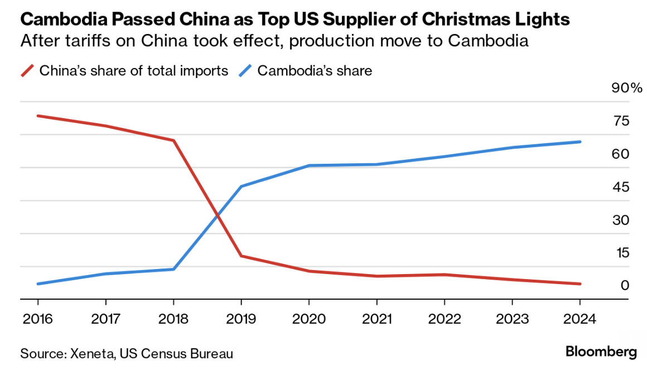
Effects of Trump I on Christmas Lights
A few key things are unclear in the case of Christmas lights that Xeneta analyzed, like whether the production actually moved from China or whether the goods were merely diverted and then packaged in Cambodia by Chinese affiliates.
Notes:
Bloomberg Supply Lines, 11/14/24
https://mail.google.com/mail/u/0/?shva=1#inbox/FMfcgzQXKDfRqwmLlHHMJDDlWNpqbKTq

Slide 45
Effects of a tariff
Do tariffs reduce a trade deficit?
  Trump thinks so, but the US deficit grew under him (see above)
  A trade deficit equals Expenditure minus Income
  There is no reason for tariffs to reduce expenditure
  And unless in a recession, also no reason for tariffs to raise income
  So NO!

Slide 46
Effects of a tariff
Government revenue
  Could Trump’s proposed tariffs replace the US income tax?
  NO!
  If imports did not fall (they would!), his tariffs would have collected in 2023:
    60% on US goods imports from China, 0.6✕$0.43tr = $0.26tr
    20% on US goods imports from non-China, 0.2✕$3.40tr = $0.68tr
    Total: $0.94tr
  US federal income tax revenue in 2023 was $2.18tr
  So his tariffs would collect AT MOST less than half of the income tax

Slide 47
Other effects of a tariff
Income distribution
  Tariffs, especially on China, raise prices of the products disproportionately bought by low-income consumers, hurting them more than high-income consumers
Retaliation
  Other countries place tariffs on US exports
  Trade war that started in 2018 continues and gets worse
Corruption
  Historically, tariffs prompted both smuggling and bribes to customs officers
  Today, in the US, those are less likely.
  But requests for exemptions from tariffs may be accompanied by favors or political contributions

Slide 48
Effects of
Trump II Tariffs

Slide 49
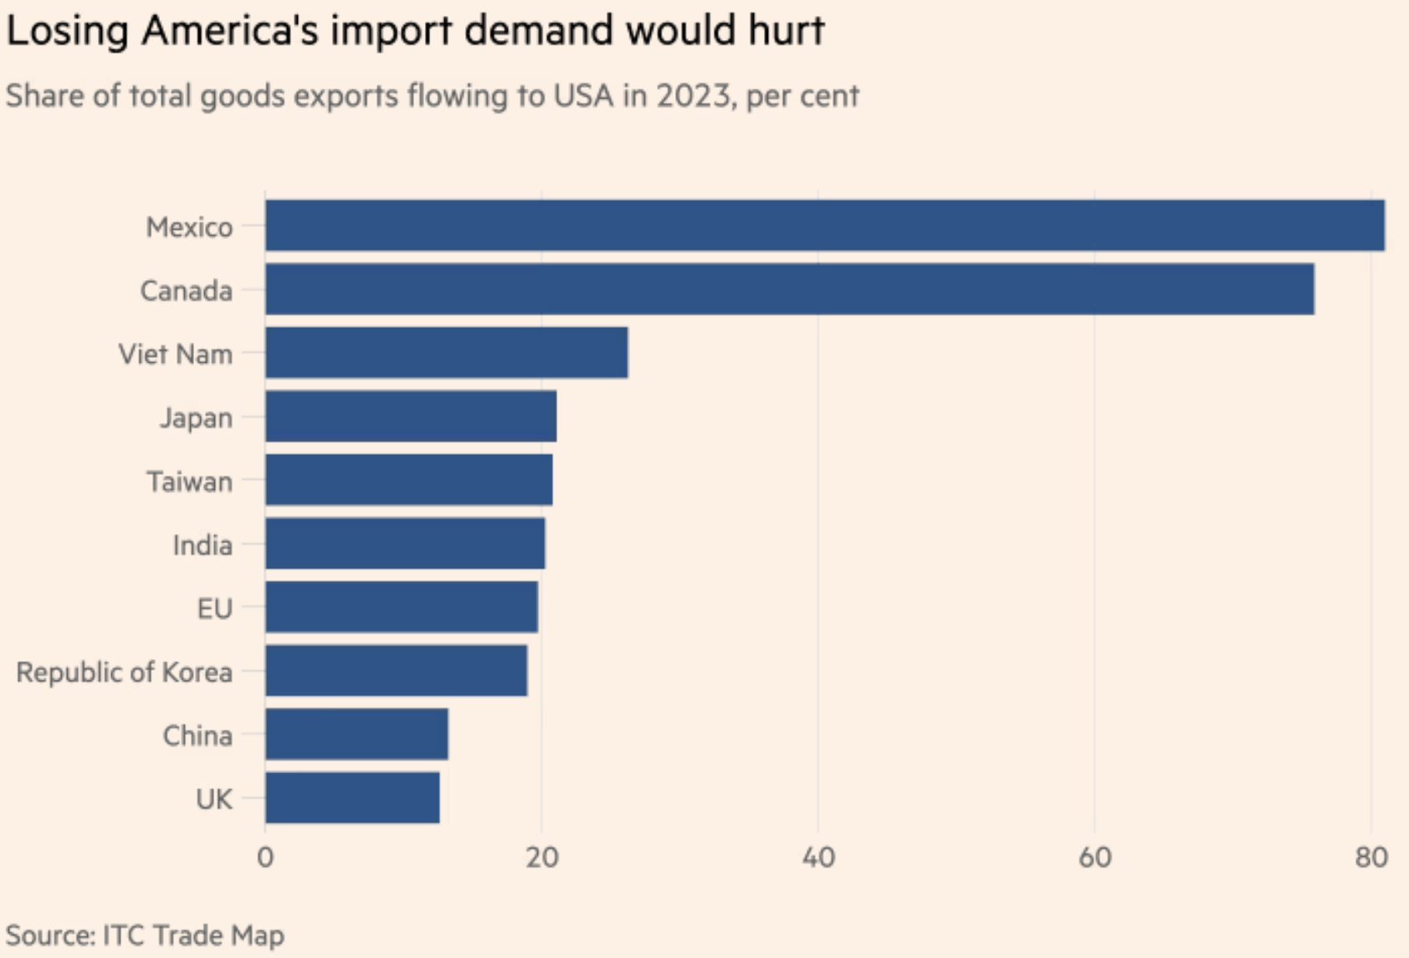
What Countries will Be Hurt?
Source:
Keynes, FT, 11/15/24
Notes:
Keynes, Soumaya, “Your guide to how to dodge a tariff,” FT, 11/15/24
https://www.ft.com/content/f9e4cc47-5b70-4beb-85df-a49a9f03181c

Slide 50
Effects of Trump II Tariffs
Source: Warwick McKibbin, Megan Hogan, and Marcus Noland, “The International Economic Implications of a Second Trump Presidency,” Working Paper 24-20, Peterson Institute of International Econnomics, September 2024
  They use a large computer model of both microeconomics and macroeconomics to calculate effects of
    Deportation of 8.3 million unauthorized immigrant workers
    Tariffs
      10% on all imports
      60% on imports from China
    Erosion of Federal Reserve independence
  Results below only for the 2 sets of tariffs
Notes:
Warwick McKibbin, Megan Hogan, and Marcus Noland, “The International Economic Implications of a Second Trump Presidency,” Working Paper 24-20, Peterson Institute of International Econnomics, September 2024.
https://www.piie.com/publications/working-papers/2024/international-economic-implications-second-trump-presidency

Slide 51
Effects of Trump Proposed Tariffs
on GDP

Slide 52
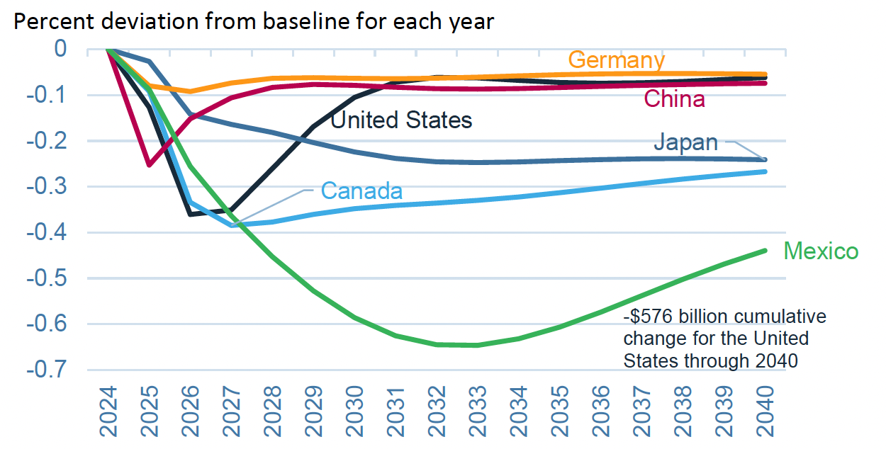
Effects of 10% Tariff on All US Imports
Real GDP
Notes:
Warwick McKibbin, Megan Hogan, and Marcus Noland, “The International Economic Implications of a Second Trump Presidency,” Working Paper 24-20, Peterson Institute of International Econnomics, September 2024.
https://www.piie.com/publications/working-papers/2024/international-economic-implications-second-trump-presidency

Slide 53
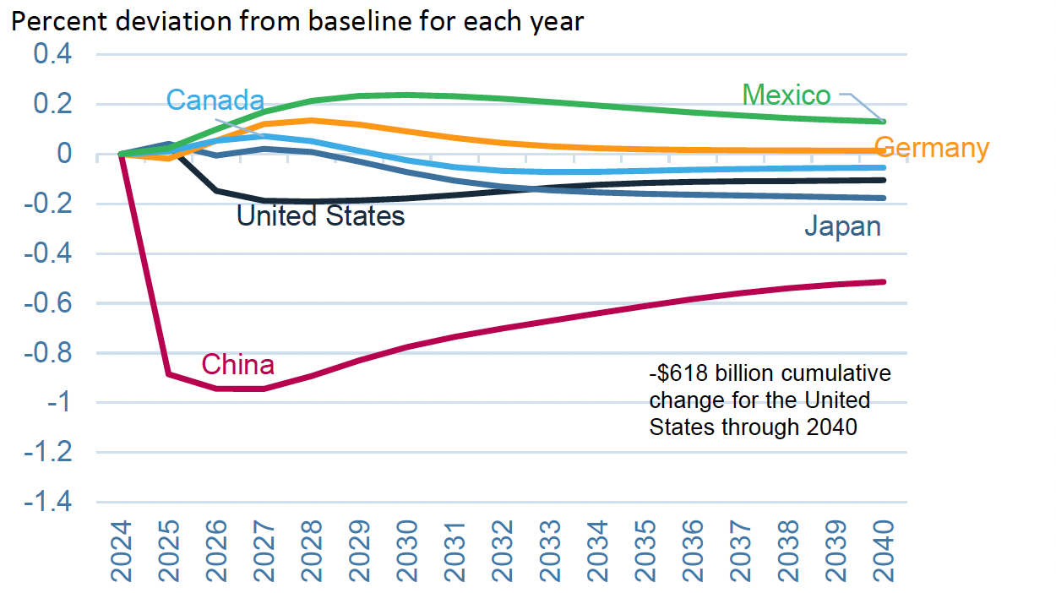
Effects of 60% Tariff on China Exports
Real GDP
Notes:
Warwick McKibbin, Megan Hogan, and Marcus Noland, “The International Economic Implications of a Second Trump Presidency,” Working Paper 24-20, Peterson Institute of International Econnomics, September 2024.
https://www.piie.com/publications/working-papers/2024/international-economic-implications-second-trump-presidency

Slide 54
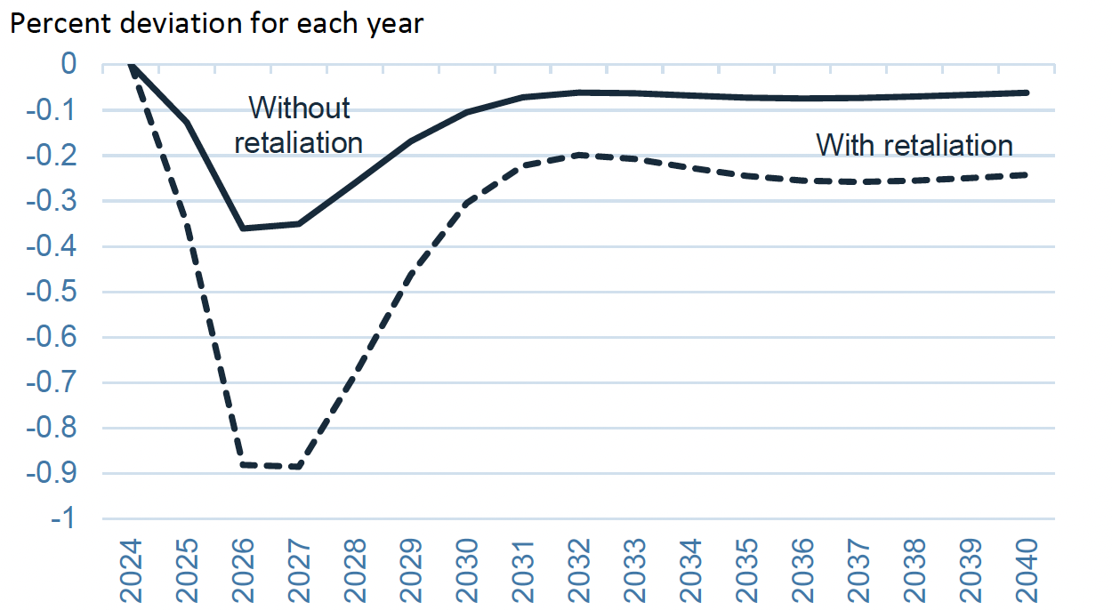
Effects of 10% Tariff on All US Imports
US GDP with and without Retaliation
Notes:
Warwick McKibbin, Megan Hogan, and Marcus Noland, “The International Economic Implications of a Second Trump Presidency,” Working Paper 24-20, Peterson Institute of International Econnomics, September 2024.
https://www.piie.com/publications/working-papers/2024/international-economic-implications-second-trump-presidency

Slide 55
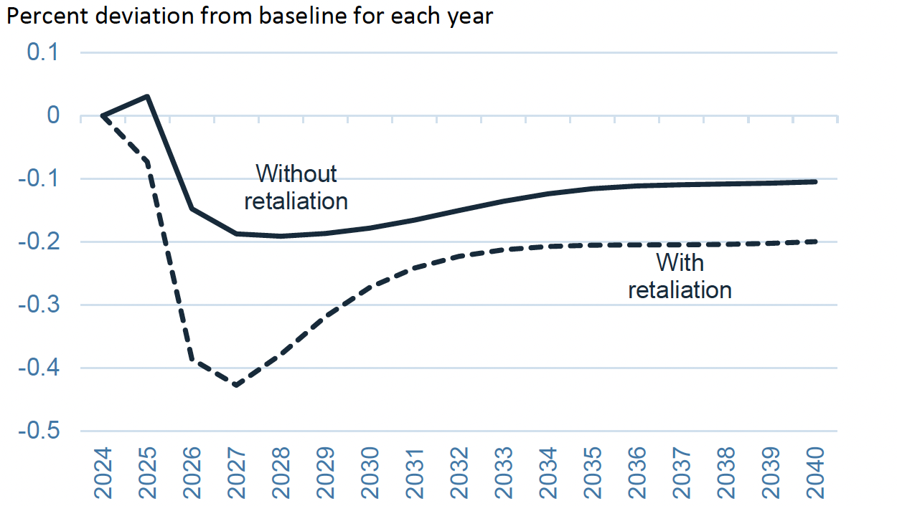
Effects of 60% Tariff on China Exports
US GDP with and without Retaliation
Notes:
Warwick McKibbin, Megan Hogan, and Marcus Noland, “The International Economic Implications of a Second Trump Presidency,” Working Paper 24-20, Peterson Institute of International Econnomics, September 2024.
https://www.piie.com/publications/working-papers/2024/international-economic-implications-second-trump-presidency

Slide 56
Effects of Trump Proposed Tariffs
on Employment

Slide 57
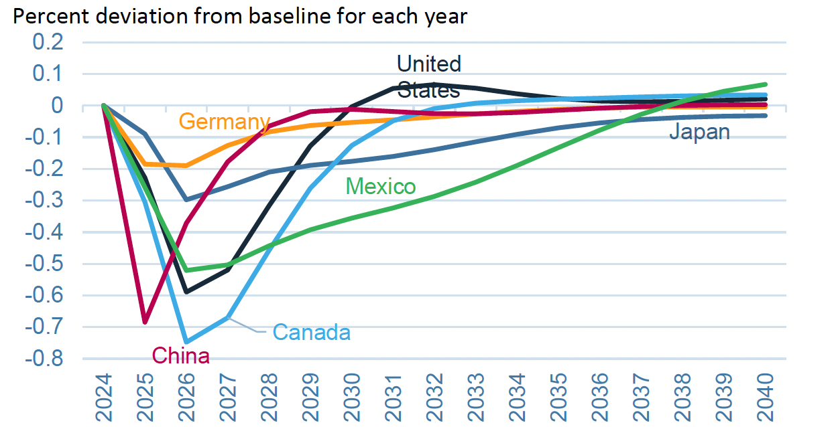
Effects of 10% Tariff on All US Imports
Employment
Notes:
Warwick McKibbin, Megan Hogan, and Marcus Noland, “The International Economic Implications of a Second Trump Presidency,” Working Paper 24-20, Peterson Institute of International Econnomics, September 2024.
https://www.piie.com/publications/working-papers/2024/international-economic-implications-second-trump-presidency

Slide 58
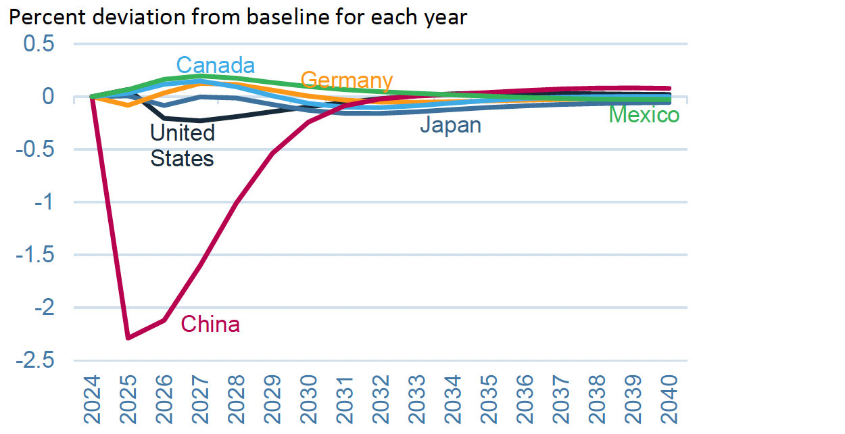
Effects of 60% Tariff on China Exports
Employment
Notes:
Warwick McKibbin, Megan Hogan, and Marcus Noland, “The International Economic Implications of a Second Trump Presidency,” Working Paper 24-20, Peterson Institute of International Econnomics, September 2024.
https://www.piie.com/publications/working-papers/2024/international-economic-implications-second-trump-presidency

Slide 59
Effects of Trump Proposed Tariffs
on Inflation

Slide 60
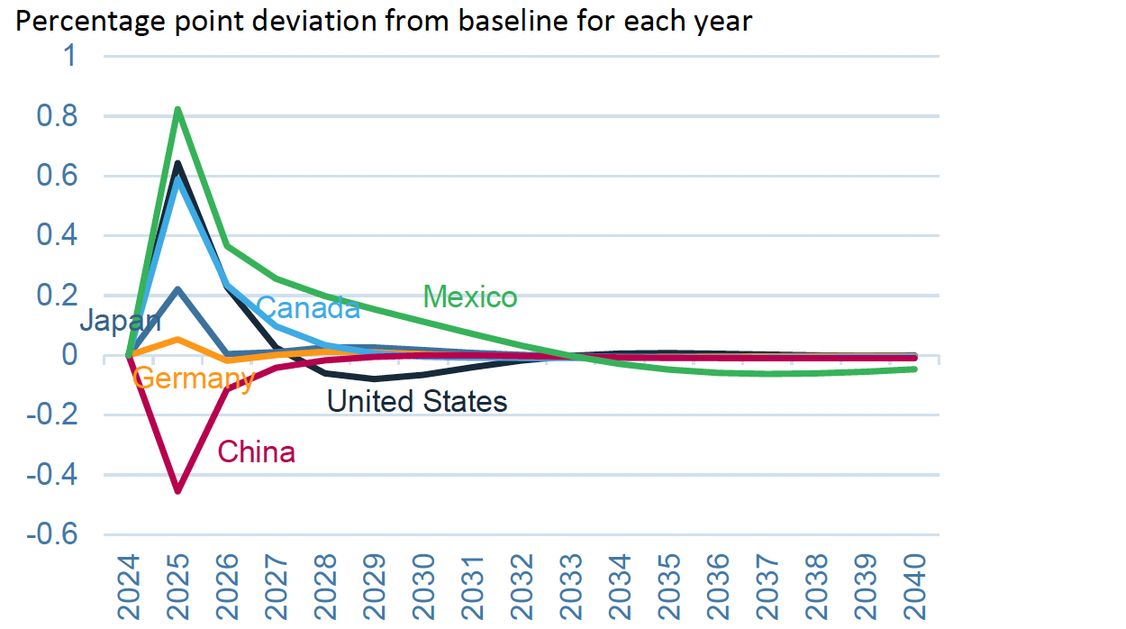
Effects of 10% Tariff on All US Imports
Inflation
Notes:
Warwick McKibbin, Megan Hogan, and Marcus Noland, “The International Economic Implications of a Second Trump Presidency,” Working Paper 24-20, Peterson Institute of International Econnomics, September 2024.
https://www.piie.com/publications/working-papers/2024/international-economic-implications-second-trump-presidency

Slide 61
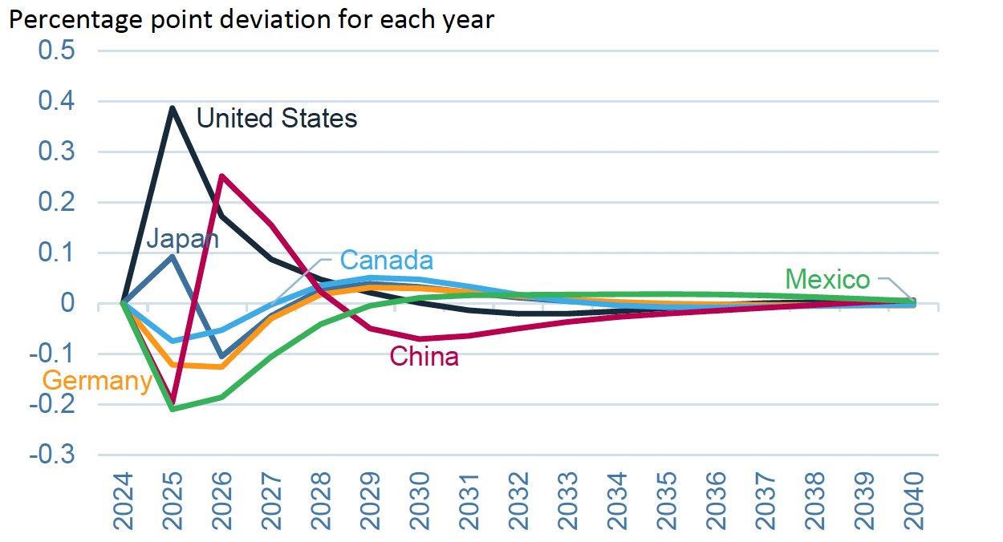
Effects of 60% Tariff on China Exports
Inflation
Notes:
Warwick McKibbin, Megan Hogan, and Marcus Noland, “The International Economic Implications of a Second Trump Presidency,” Working Paper 24-20, Peterson Institute of International Econnomics, September 2024.
https://www.piie.com/publications/working-papers/2024/international-economic-implications-second-trump-presidency

Slide 62
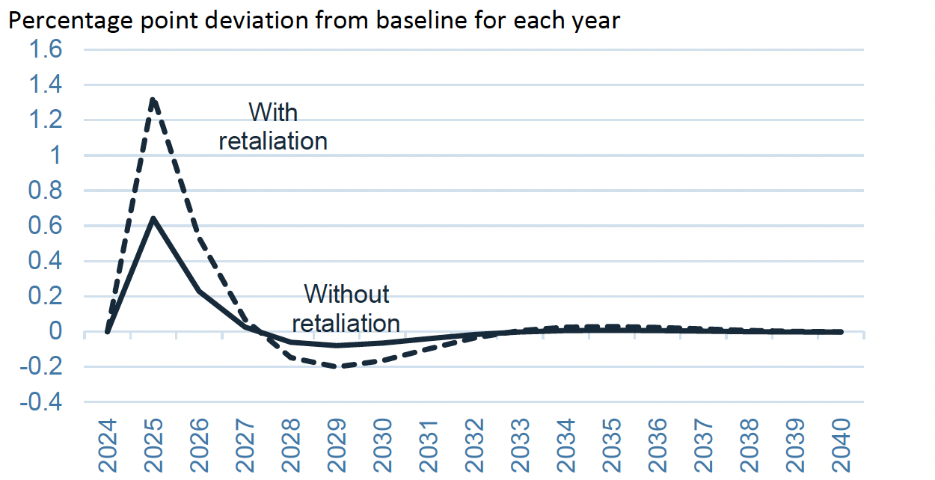
Effects of 10% Tariff on All US Imports
US Inflation with and without Retaliation
Notes:
Warwick McKibbin, Megan Hogan, and Marcus Noland, “The International Economic Implications of a Second Trump Presidency,” Working Paper 24-20, Peterson Institute of International Econnomics, September 2024.
https://www.piie.com/publications/working-papers/2024/international-economic-implications-second-trump-presidency

Slide 63
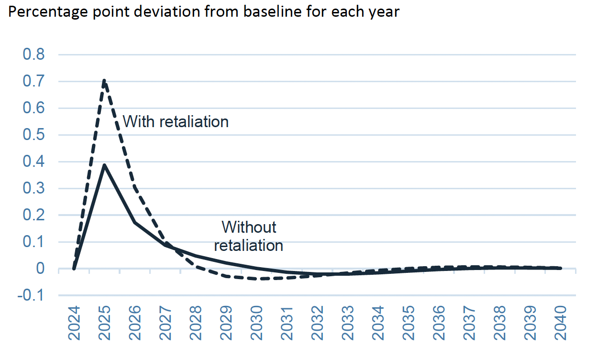
Effects of 60% Tariff on China Exports
US Inflation with and without Retaliation
Notes:
Warwick McKibbin, Megan Hogan, and Marcus Noland, “The International Economic Implications of a Second Trump Presidency,” Working Paper 24-20, Peterson Institute of International Econnomics, September 2024.
https://www.piie.com/publications/working-papers/2024/international-economic-implications-second-trump-presidency

Slide 64
Effects of Trump Proposed Tariffs
on Trade Surplus

Slide 65
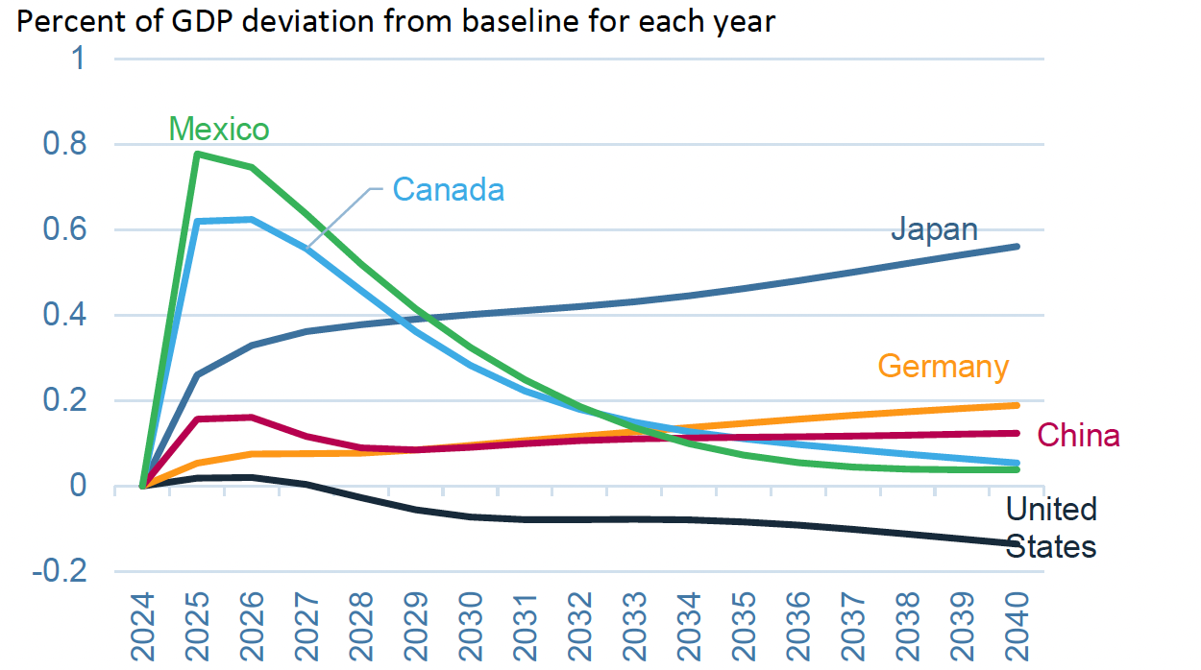
Effects of 10% Tariff on All US Imports
Trade Surplus
Notes:
Warwick McKibbin, Megan Hogan, and Marcus Noland, “The International Economic Implications of a Second Trump Presidency,” Working Paper 24-20, Peterson Institute of International Econnomics, September 2024.
https://www.piie.com/publications/working-papers/2024/international-economic-implications-second-trump-presidency

Slide 66
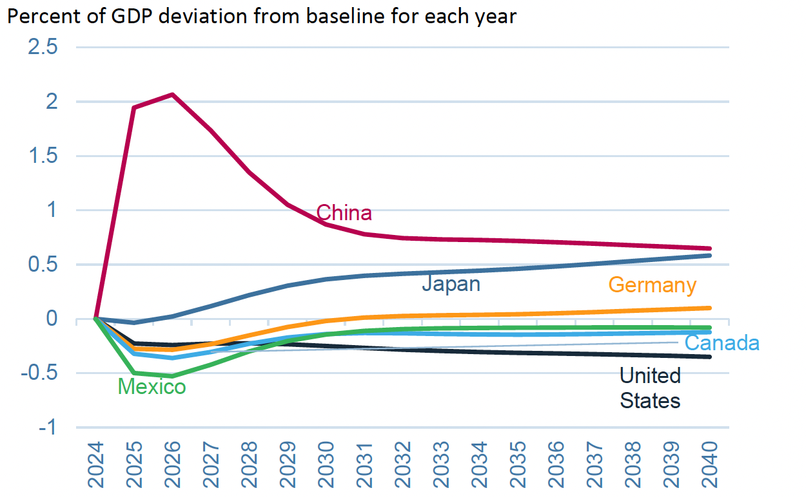
Effects of 60% Tariff on China Exports
Trade Surplus
Notes:
Warwick McKibbin, Megan Hogan, and Marcus Noland, “The International Economic Implications of a Second Trump Presidency,” Working Paper 24-20, Peterson Institute of International Econnomics, September 2024.
https://www.piie.com/publications/working-papers/2024/international-economic-implications-second-trump-presidency

Slide 67
Effects of Trump Proposed Tariffs
on Sectoral
Production

Slide 68
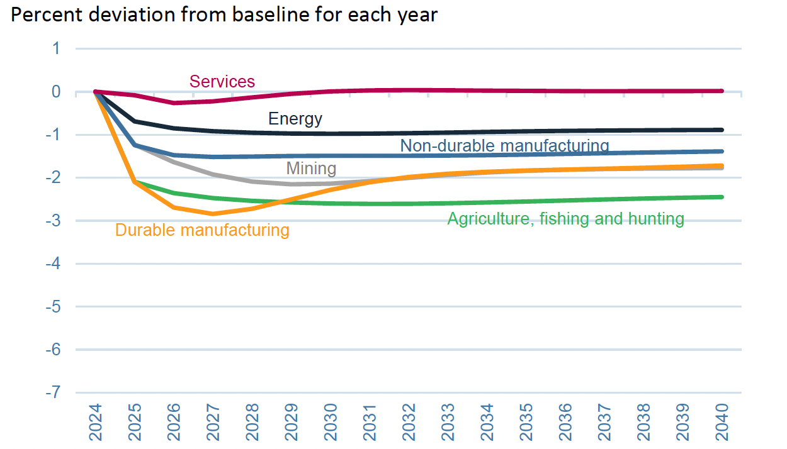
Effects of 10% Tariff on All US Imports
US Sectoral Production
Notes:
Warwick McKibbin, Megan Hogan, and Marcus Noland, “The International Economic Implications of a Second Trump Presidency,” Working Paper 24-20, Peterson Institute of International Econnomics, September 2024.
https://www.piie.com/publications/working-papers/2024/international-economic-implications-second-trump-presidency

Slide 69
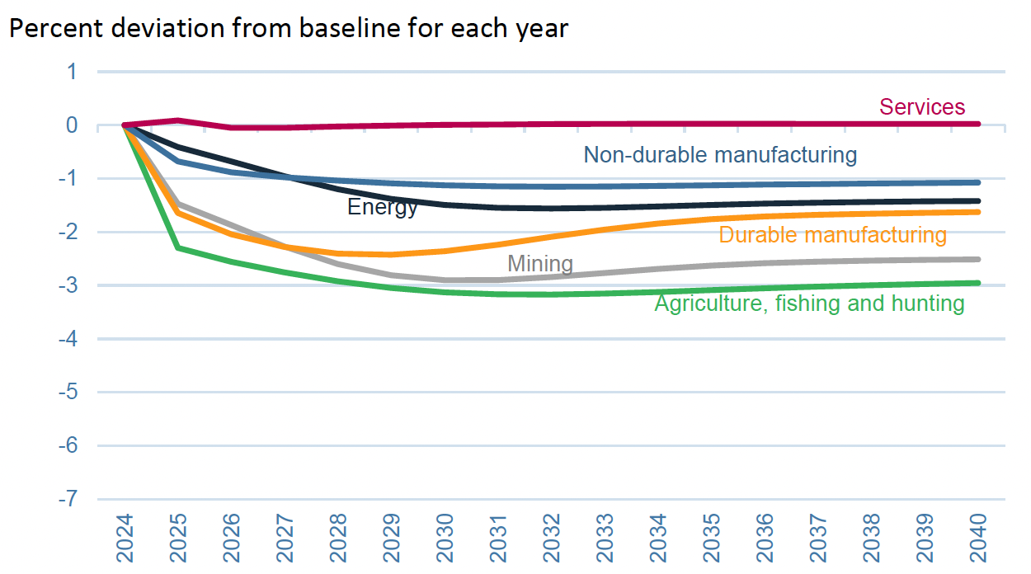
Effects of 60% Tariff on China Exports
US Sectoral Production
Notes:
Warwick McKibbin, Megan Hogan, and Marcus Noland, “The International Economic Implications of a Second Trump Presidency,” Working Paper 24-20, Peterson Institute of International Econnomics, September 2024.
https://www.piie.com/publications/working-papers/2024/international-economic-implications-second-trump-presidency

Slide 70
Effects of Trump Proposed Tariffs
on Sectoral
Employment

Slide 71
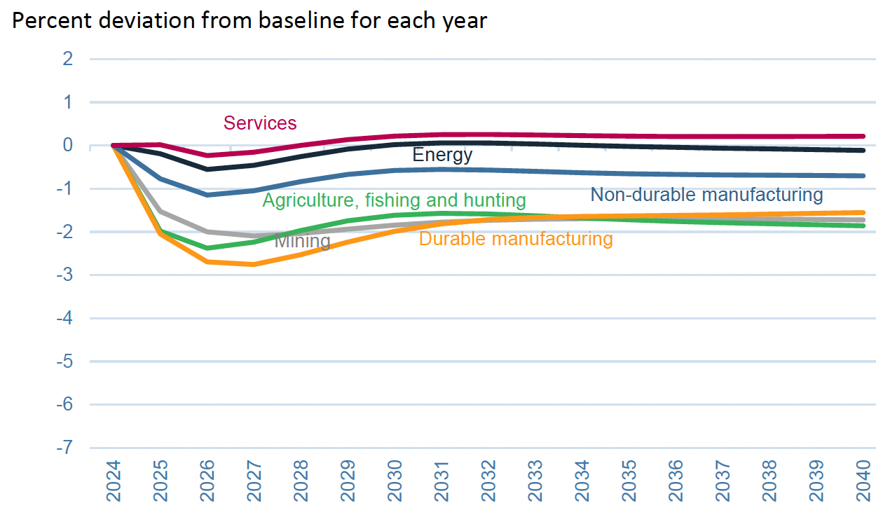
Effects of 10% Tariff on All US Imports
US Sectoral Employment
Notes:
Warwick McKibbin, Megan Hogan, and Marcus Noland, “The International Economic Implications of a Second Trump Presidency,” Working Paper 24-20, Peterson Institute of International Econnomics, September 2024.
https://www.piie.com/publications/working-papers/2024/international-economic-implications-second-trump-presidency

Slide 72
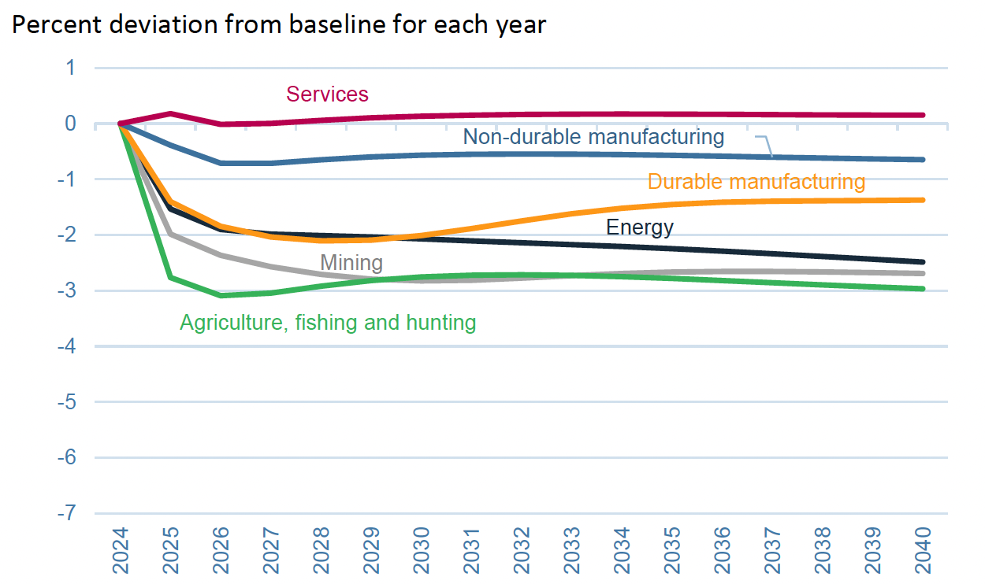
Effects of 60% Tariff on China Exports
US Sectoral Employment
Notes:
Warwick McKibbin, Megan Hogan, and Marcus Noland, “The International Economic Implications of a Second Trump Presidency,” Working Paper 24-20, Peterson Institute of International Econnomics, September 2024.
https://www.piie.com/publications/working-papers/2024/international-economic-implications-second-trump-presidency

Slide 73
Effects of Trump Proposed Tariffs
on Sectoral
Prices

Slide 74
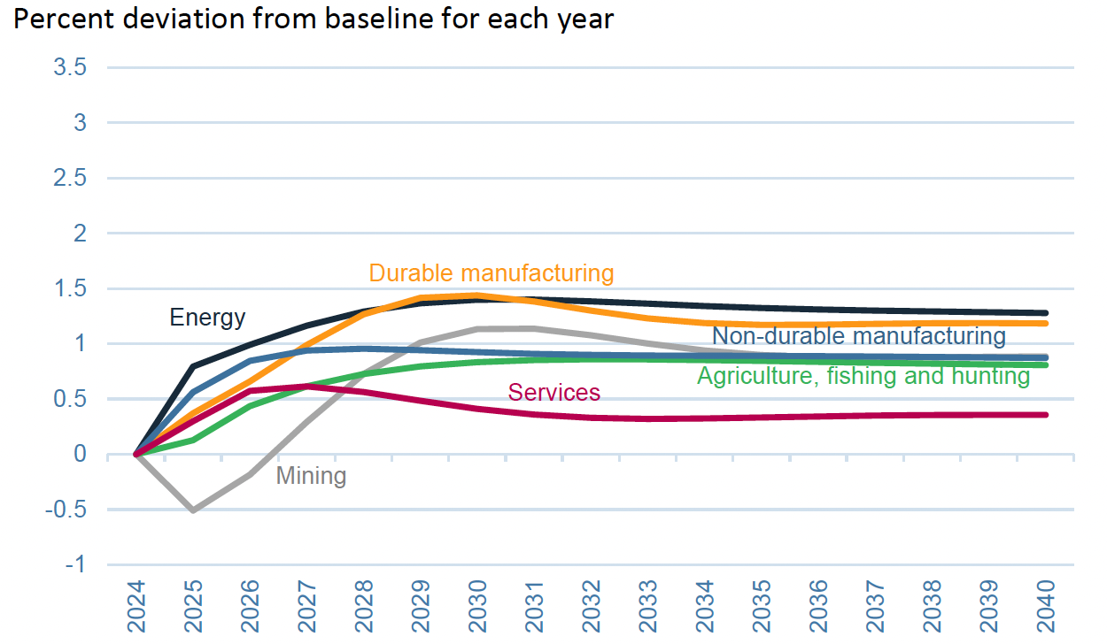
Effects of 10% Tariff on All US Imports
Sectoral Prices
Notes:
Warwick McKibbin, Megan Hogan, and Marcus Noland, “The International Economic Implications of a Second Trump Presidency,” Working Paper 24-20, Peterson Institute of International Econnomics, September 2024.
https://www.piie.com/publications/working-papers/2024/international-economic-implications-second-trump-presidency

Slide 75
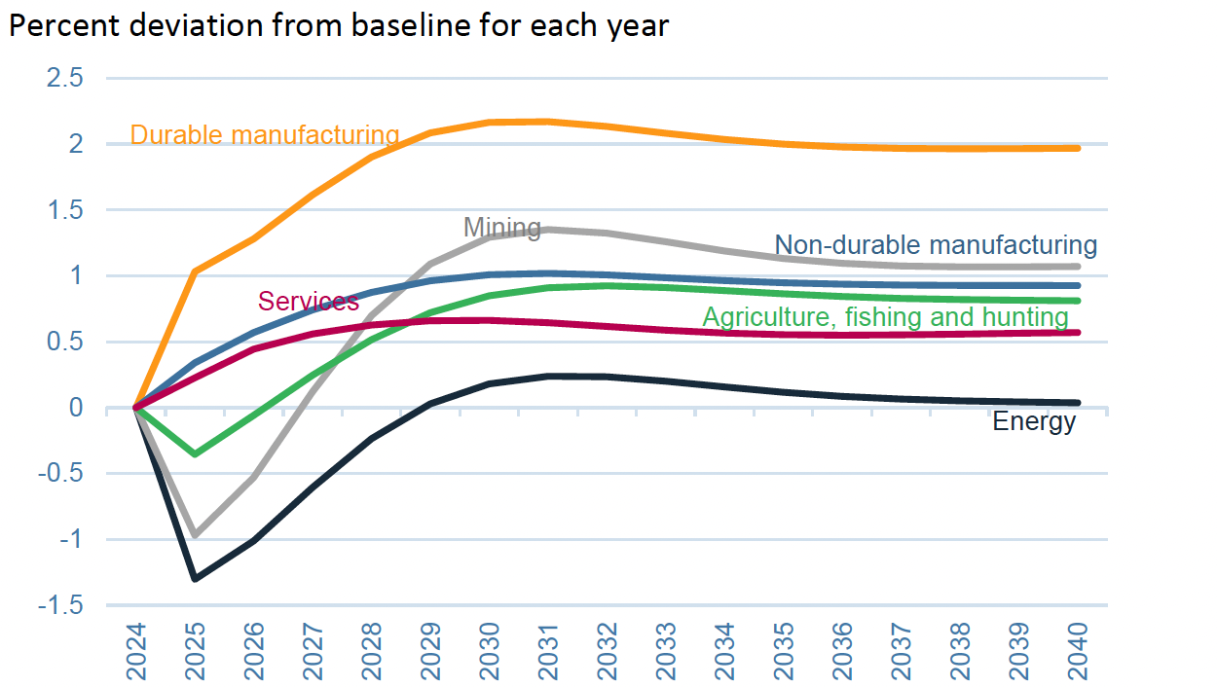
Effects of 60% Tariff on China Exports
US Sectoral Prices
Notes:
Warwick McKibbin, Megan Hogan, and Marcus Noland, “The International Economic Implications of a Second Trump Presidency,” Working Paper 24-20, Peterson Institute of International Econnomics, September 2024.
https://www.piie.com/publications/working-papers/2024/international-economic-implications-second-trump-presidency

Slide 76
Effects of Trump Proposed Tariffs
Which products come from
which countries?
SourceP. Luis Melgar and Rachel Lerman, “See which products Trump’s tariffs could make more expensive,” Washington Post, December 5, 2024.

Slide 77
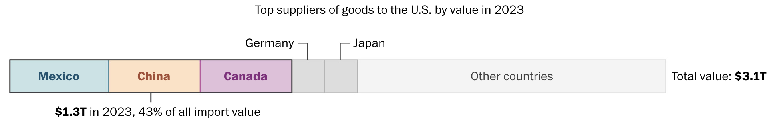
Notes:
Luis Melgar and Rachel Lerman, “See which products Trump’s tariffs could make more expensive,” Washington Post, December 5, 2024.
https://www.washingtonpost.com/business/2024/12/05/trump-china-mexico-canada-tariffs-prices/?utm_campaign=wp_evening_edition&utm_medium=email&utm_source=newsletter&carta-url=https%3A%2F%2Fs2.washingtonpost.com%2Fcar-ln-tr%2F3fd6330%2F67522261e179af1b45e73c5e%2F597273baade4e21a847d94bd%2F27%2F50%2F67522261e179af1b45e73c5e

Slide 78
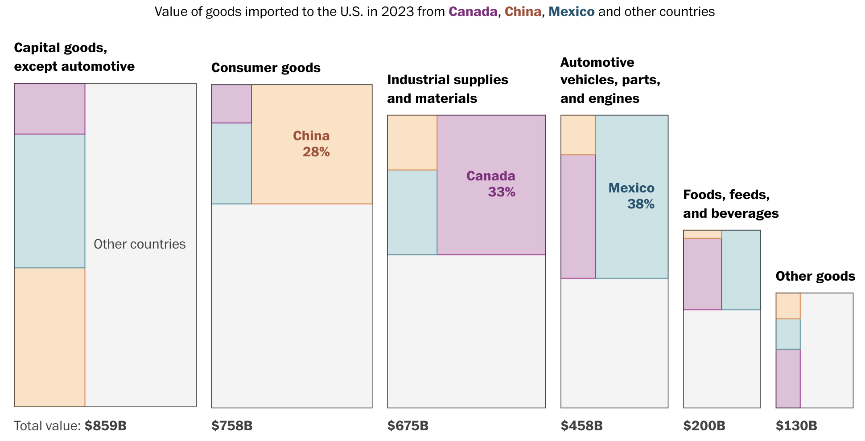
Notes:
Luis Melgar and Rachel Lerman, “See which products Trump’s tariffs could make more expensive,” Washington Post, December 5, 2024.
https://www.washingtonpost.com/business/2024/12/05/trump-china-mexico-canada-tariffs-prices/?utm_campaign=wp_evening_edition&utm_medium=email&utm_source=newsletter&carta-url=https%3A%2F%2Fs2.washingtonpost.com%2Fcar-ln-tr%2F3fd6330%2F67522261e179af1b45e73c5e%2F597273baade4e21a847d94bd%2F27%2F50%2F67522261e179af1b45e73c5e

Slide 79
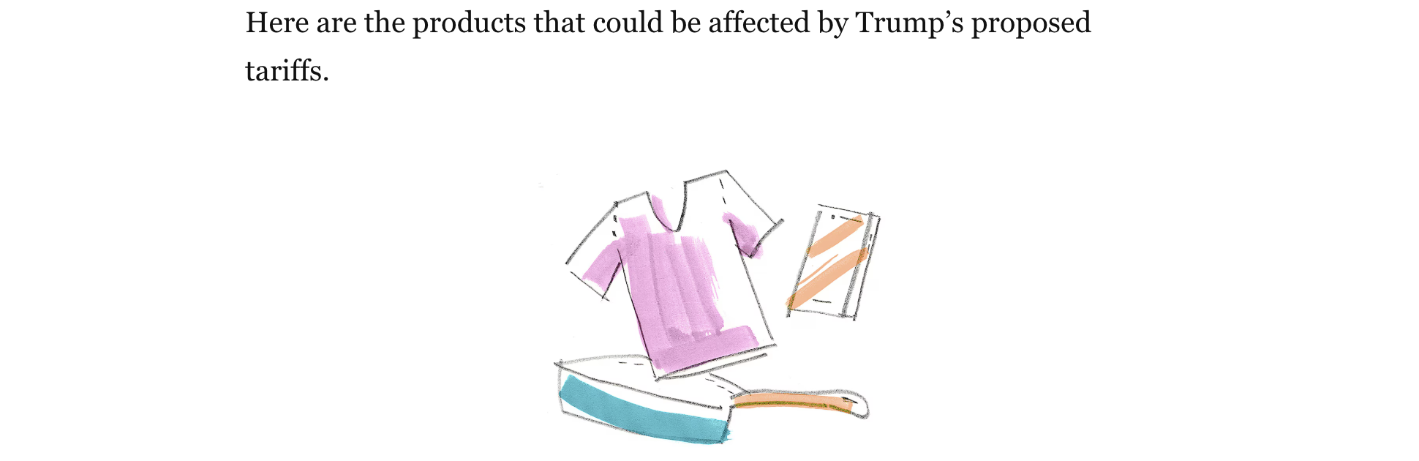
Notes:
Luis Melgar and Rachel Lerman, “See which products Trump’s tariffs could make more expensive,” Washington Post, December 5, 2024.
https://www.washingtonpost.com/business/2024/12/05/trump-china-mexico-canada-tariffs-prices/?utm_campaign=wp_evening_edition&utm_medium=email&utm_source=newsletter&carta-url=https%3A%2F%2Fs2.washingtonpost.com%2Fcar-ln-tr%2F3fd6330%2F67522261e179af1b45e73c5e%2F597273baade4e21a847d94bd%2F27%2F50%2F67522261e179af1b45e73c5e

Slide 80
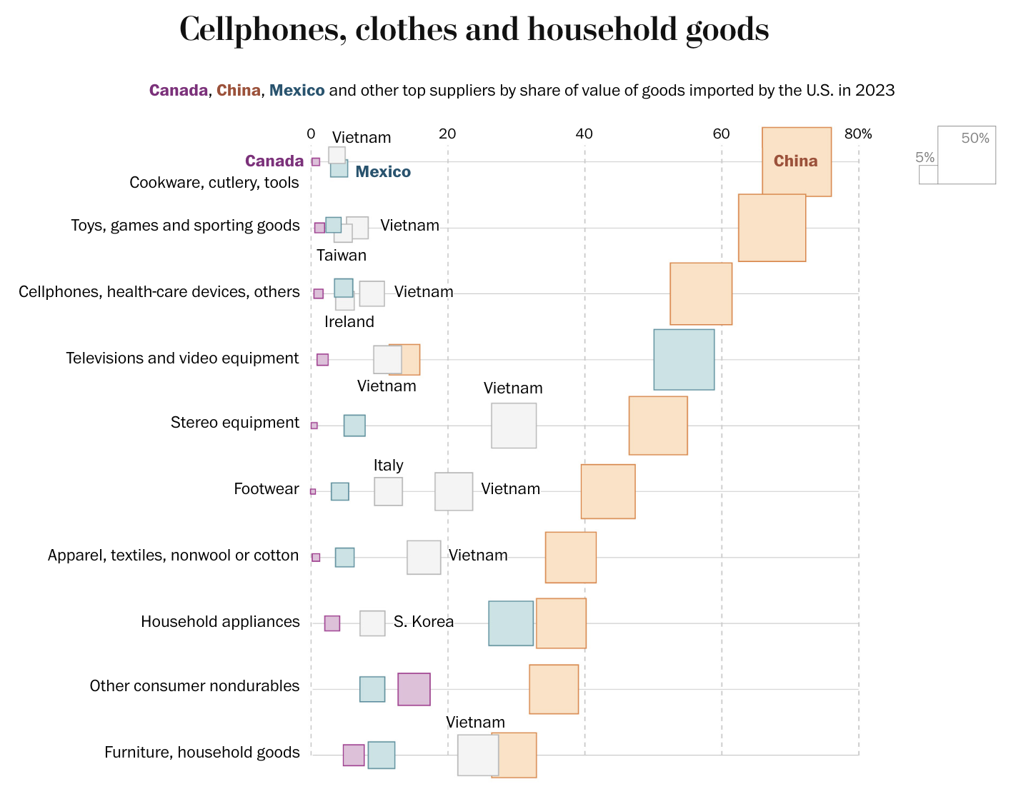
Notes:
Luis Melgar and Rachel Lerman, “See which products Trump’s tariffs could make more expensive,” Washington Post, December 5, 2024.
https://www.washingtonpost.com/business/2024/12/05/trump-china-mexico-canada-tariffs-prices/?utm_campaign=wp_evening_edition&utm_medium=email&utm_source=newsletter&carta-url=https%3A%2F%2Fs2.washingtonpost.com%2Fcar-ln-tr%2F3fd6330%2F67522261e179af1b45e73c5e%2F597273baade4e21a847d94bd%2F27%2F50%2F67522261e179af1b45e73c5e

Slide 81
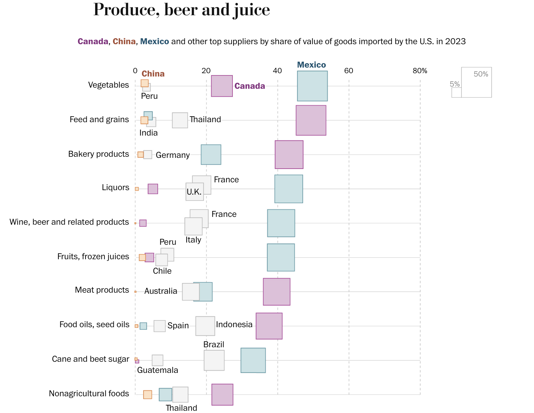
Notes:
Luis Melgar and Rachel Lerman, “See which products Trump’s tariffs could make more expensive,” Washington Post, December 5, 2024.
https://www.washingtonpost.com/business/2024/12/05/trump-china-mexico-canada-tariffs-prices/?utm_campaign=wp_evening_edition&utm_medium=email&utm_source=newsletter&carta-url=https%3A%2F%2Fs2.washingtonpost.com%2Fcar-ln-tr%2F3fd6330%2F67522261e179af1b45e73c5e%2F597273baade4e21a847d94bd%2F27%2F50%2F67522261e179af1b45e73c5e

Slide 82
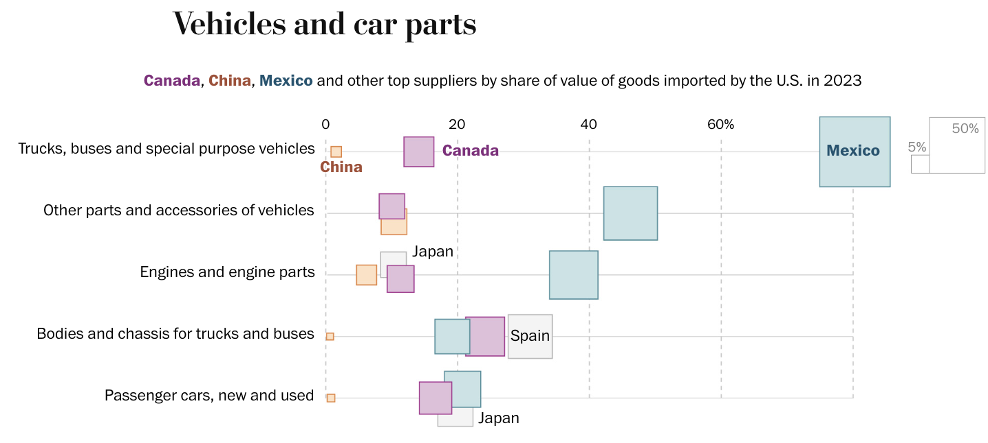
Notes:
Luis Melgar and Rachel Lerman, “See which products Trump’s tariffs could make more expensive,” Washington Post, December 5, 2024.
https://www.washingtonpost.com/business/2024/12/05/trump-china-mexico-canada-tariffs-prices/?utm_campaign=wp_evening_edition&utm_medium=email&utm_source=newsletter&carta-url=https%3A%2F%2Fs2.washingtonpost.com%2Fcar-ln-tr%2F3fd6330%2F67522261e179af1b45e73c5e%2F597273baade4e21a847d94bd%2F27%2F50%2F67522261e179af1b45e73c5e

Slide 83
Next Week

Slide 84
Thank you!
Questions?
See slides on my website
https://websites.umich.edu/~alandear/presentations/

Slide 85
Notes:
Luis Melgar and Rachel Lerman, “See which products Trump’s tariffs could make more expensive,” Washington Post, December 5, 2024.
https://www.washingtonpost.com/business/2024/12/05/trump-china-mexico-canada-tariffs-prices/?utm_campaign=wp_evening_edition&utm_medium=email&utm_source=newsletter&carta-url=https%3A%2F%2Fs2.washingtonpost.com%2Fcar-ln-tr%2F3fd6330%2F67522261e179af1b45e73c5e%2F597273baade4e21a847d94bd%2F27%2F50%2F67522261e179af1b45e73c5e

